Slide 1
Microbiome
Phuc Loi Luu, PhD
luu.p.loi@googlemail.com
June 27 2024

Slide 2
Content
Review Next Generation Sequencing (NGS) technology
Terms: Metagenomics, Metagenome, Microbe, Microbiomics, Microbiome, Microbiota
Target vs shotgun metagenomics
Application of matgenomics
Discussion

Slide 3
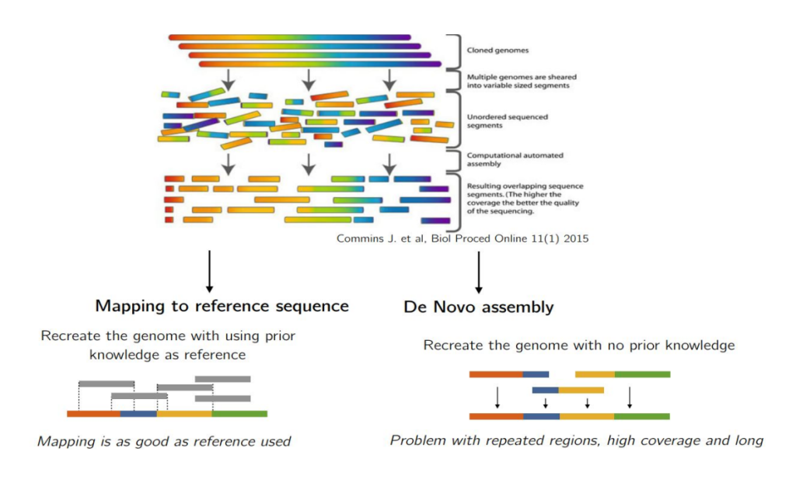
Genome Shotgun Sequencing and Assembly
https://pharmafeatures.com/cracking-genetic-ciphers-secondary-ngs-analysis/

Slide 4
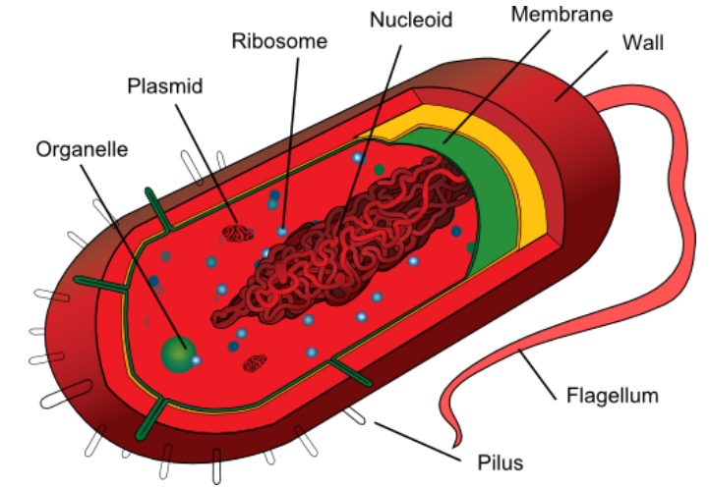
What are microbes?
Cell structure

Slide 5
What are microbes?
Some key differences from eukaryota (e.g. humans, plants):
• Haploid genome
• Single circular chromosome, sometimes plasmids
• Genetic malleability, metabolic diversity
• Usually no nucleus (prokaryotes)
• Relatively easy interspecies gene transfer

Slide 6
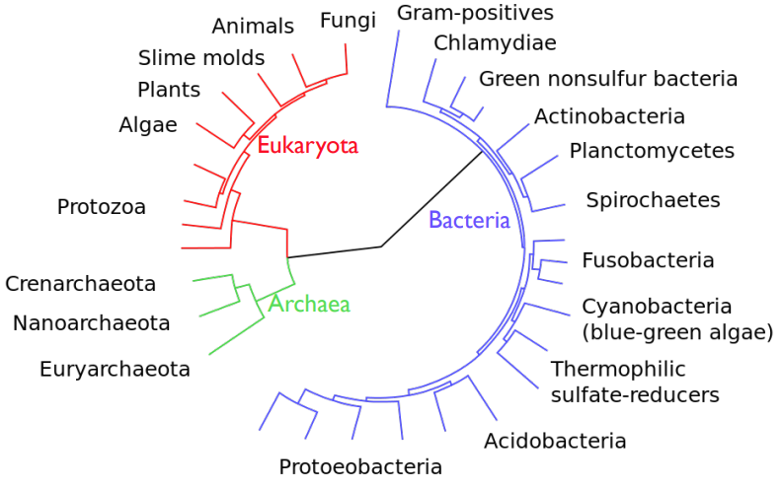
What are microbes?

Slide 7
Terms
Microbiome: Attributed to Joshua Lederberg by Hooper and Gordon (2001): “the collective genome of our indigenous microbes (microflora), the idea being that a comprehensive genetic view of Homo sapiens as a life-form should include the genes in our microbiome”
Microbiota: the actual set of microorganisms found in a particular setting (semi-interchangably with Microbiome as some interpret Microbiome as Microbial Biome) – http://microbe.net/2015/04/08/what-does-the-term-microbiome-mean-and-where-did-it-come-from-a-bit-of-a-surprise/
Metagenome: Handelsman et al. (1998) “…advances in molecular biology and eukaryotic genomics, which have laid the groundwork for cloning and functional analysis of the collective genomes of soil microflora, which we term the metagenome of the soil.”– Meta = Beyond
Does not encompass marker-gene surveys (e.g., 16S)

Slide 8
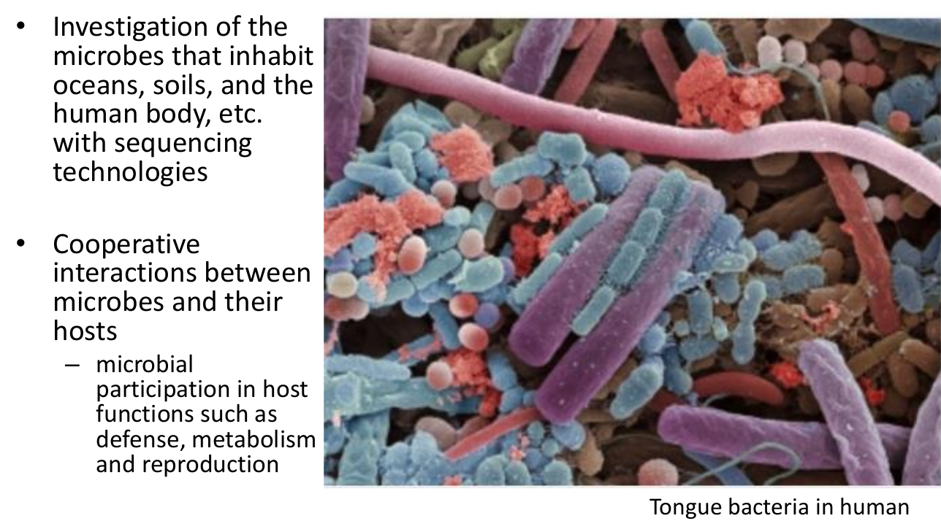
Metagenomics

Slide 9
Metagenomics
Human microbiota: 100 trillion micriobial cells, 10 times as many as human cells?
Human microbiome
– Consists of archaea, bacteria, and viruses
– What are the composition and gene content of human microbiome?
– What are the differences of microbiome composition across
individuals?
– What are the differences of microbiome composition across body parts?

Slide 10
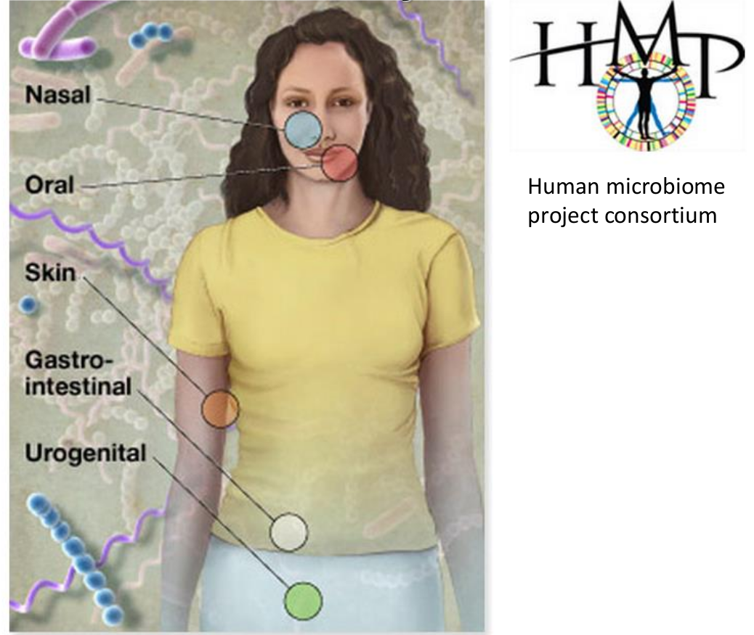
Sampling of a new environment: the human body

Slide 11
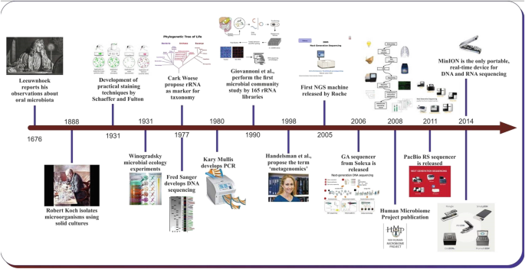
Time of development of Microbiome

Slide 12
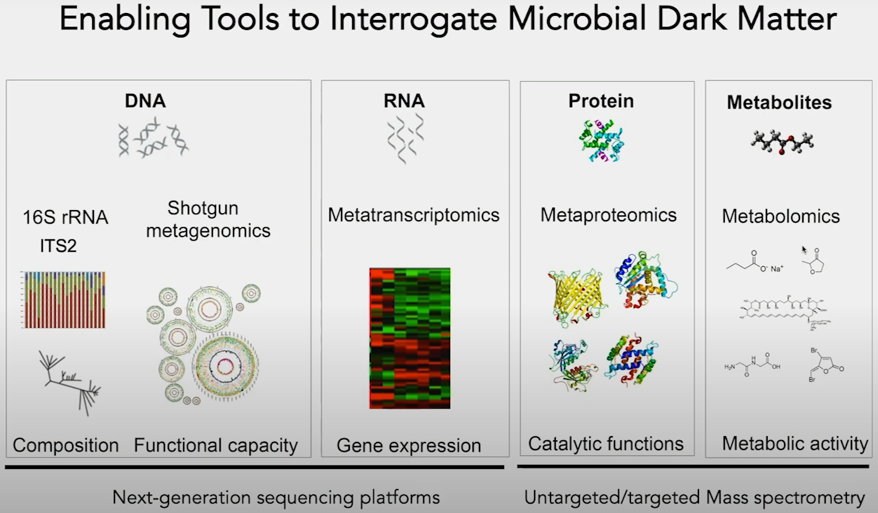

Slide 13
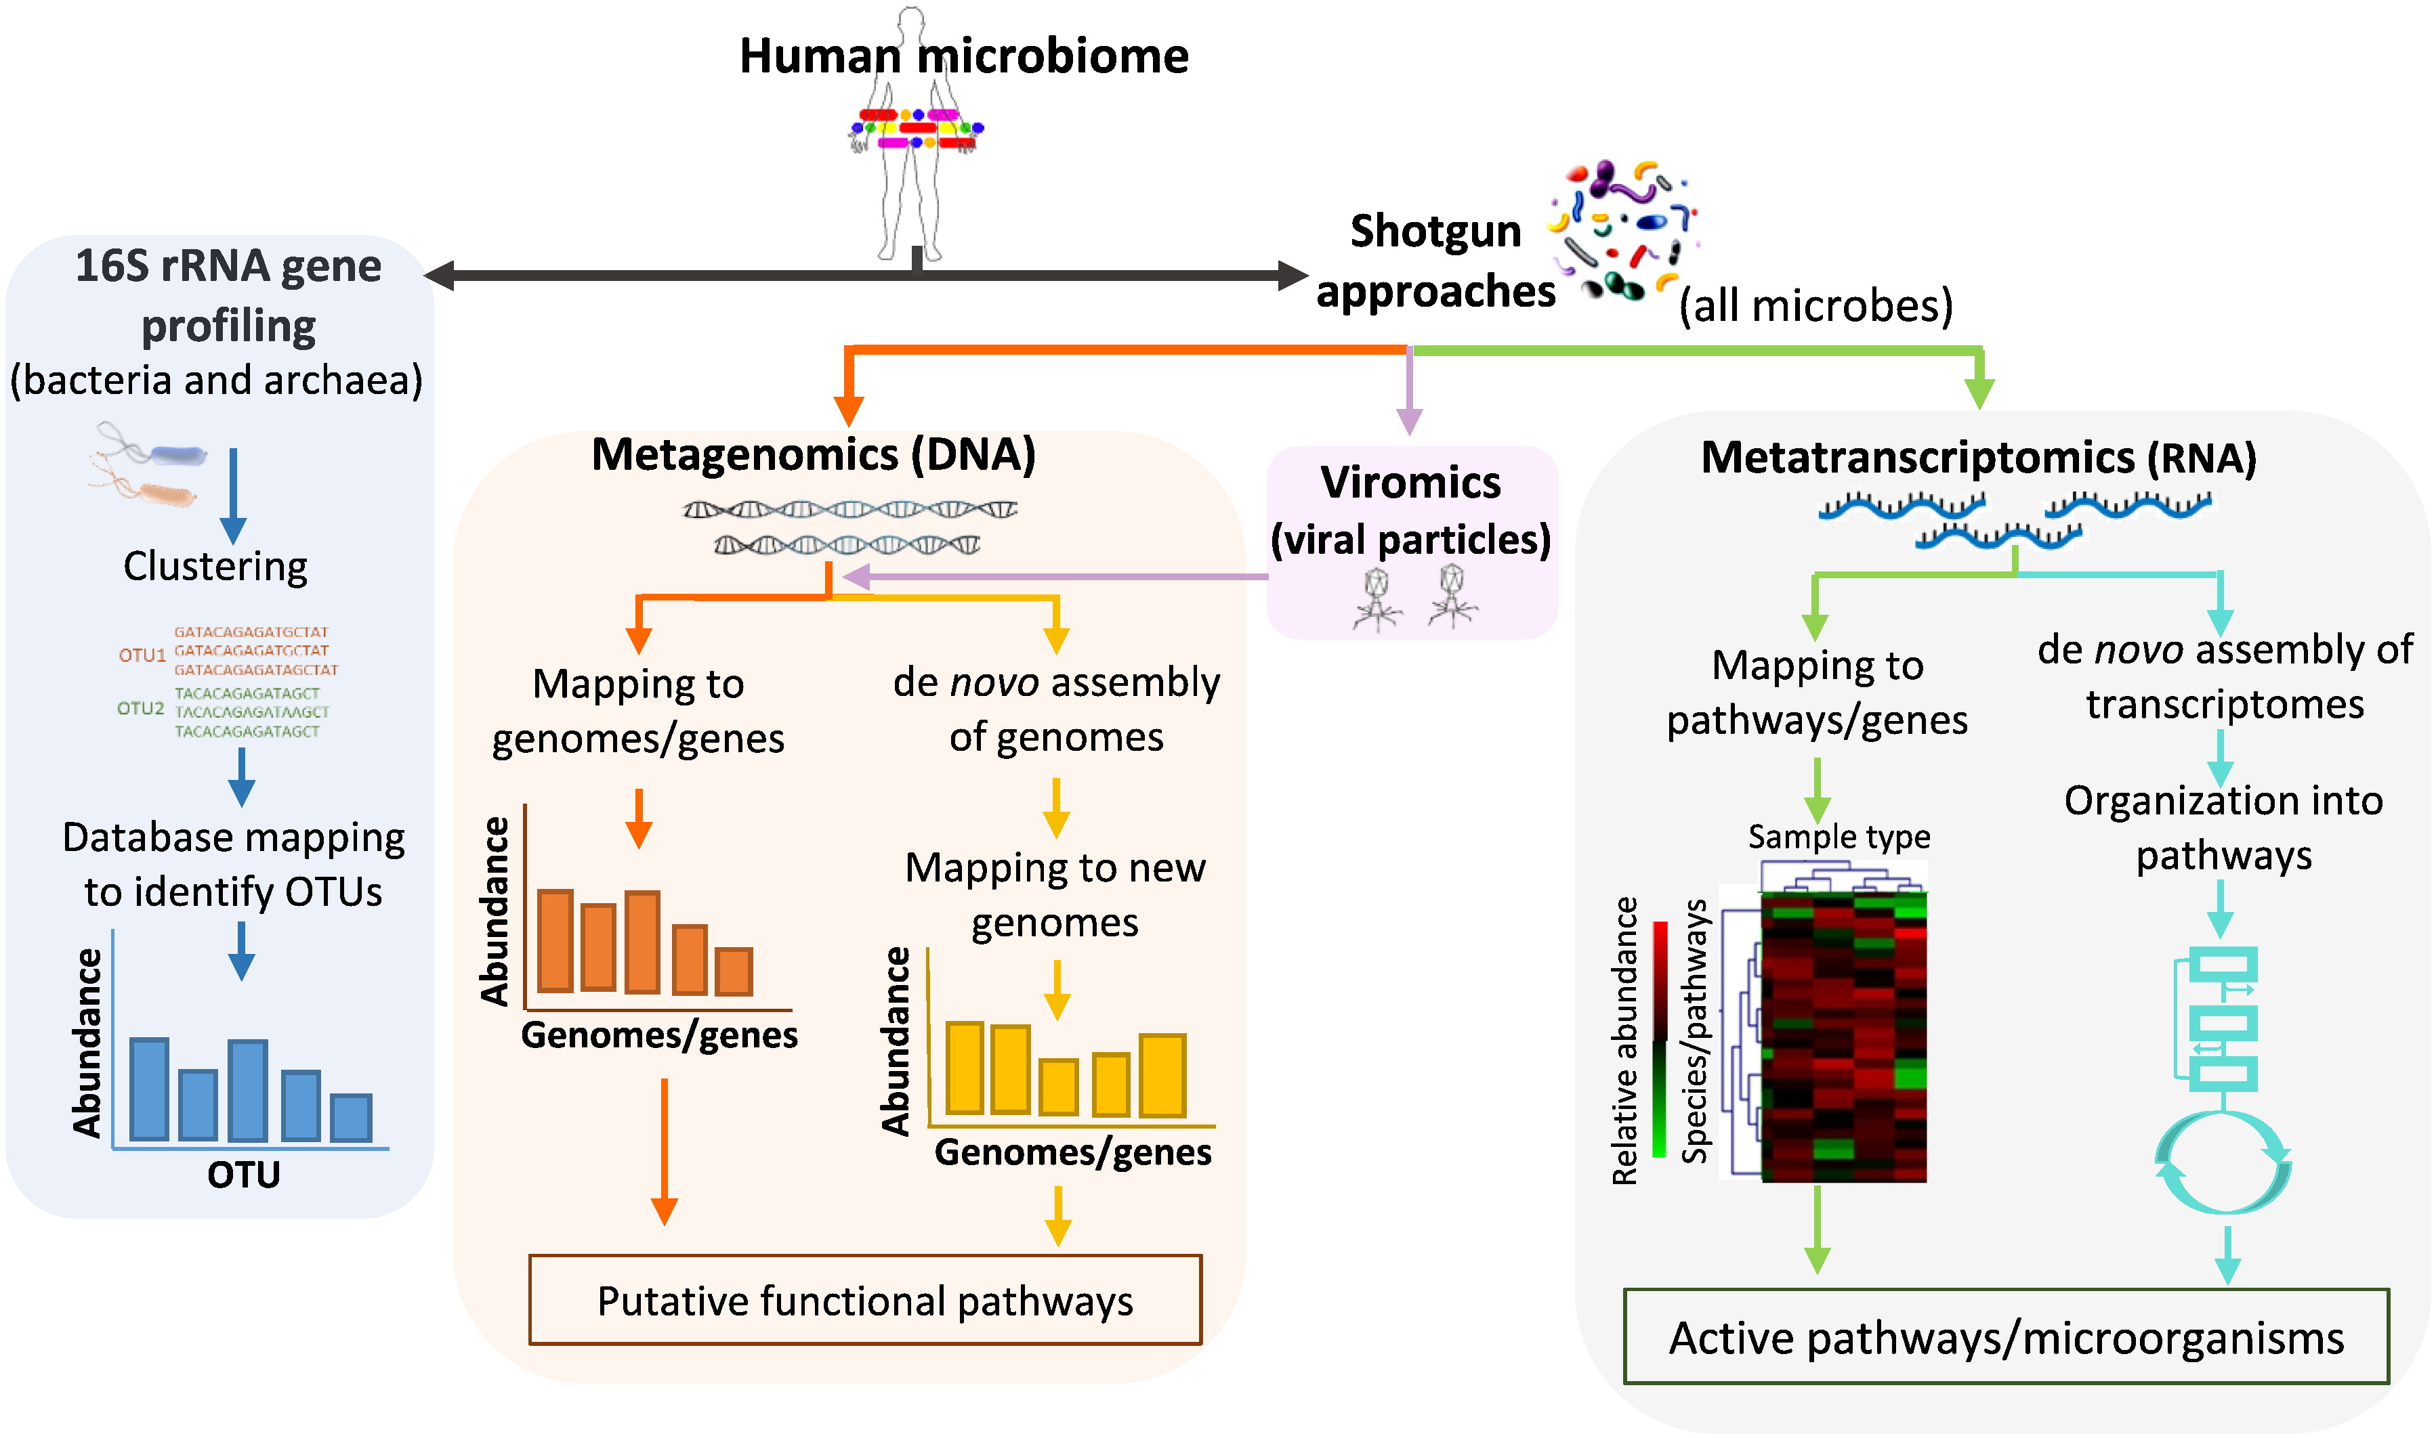
Microbiome profiling with metagenomics
10.1016/j.csbj.2015.06.001

Slide 14
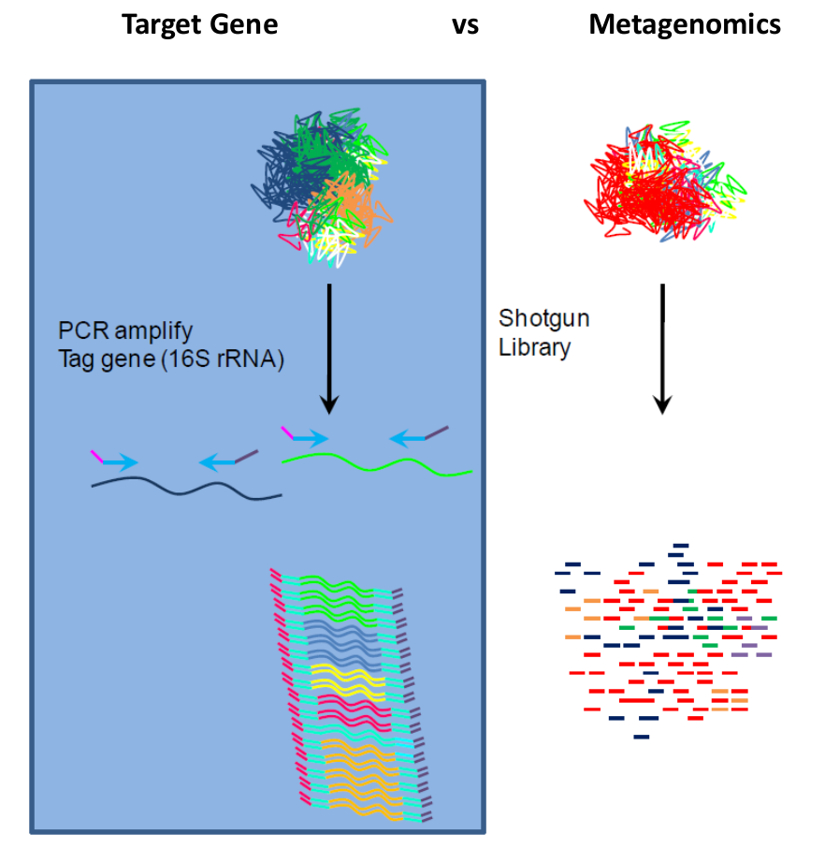

Slide 15
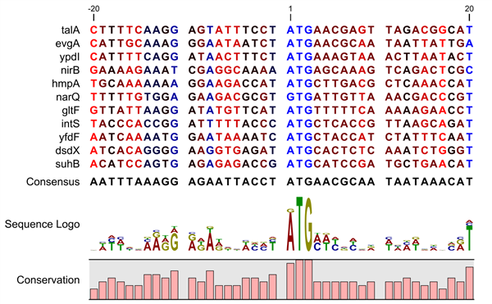
16s rRNA gene as a proxy for taxonomic assignment
https://resources.qiagenbioinformatics.com/manuals/clcgenomicsworkbench/current/index.php?manual=BE_Sequence_logo.html

Slide 16
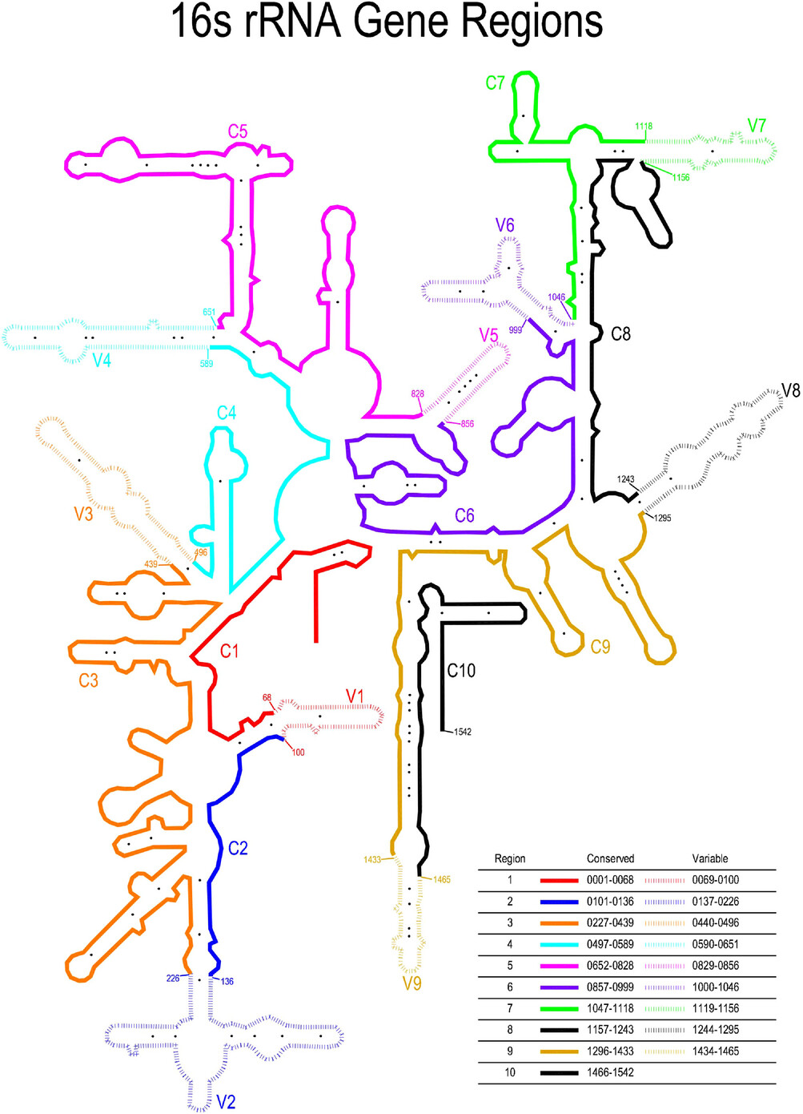
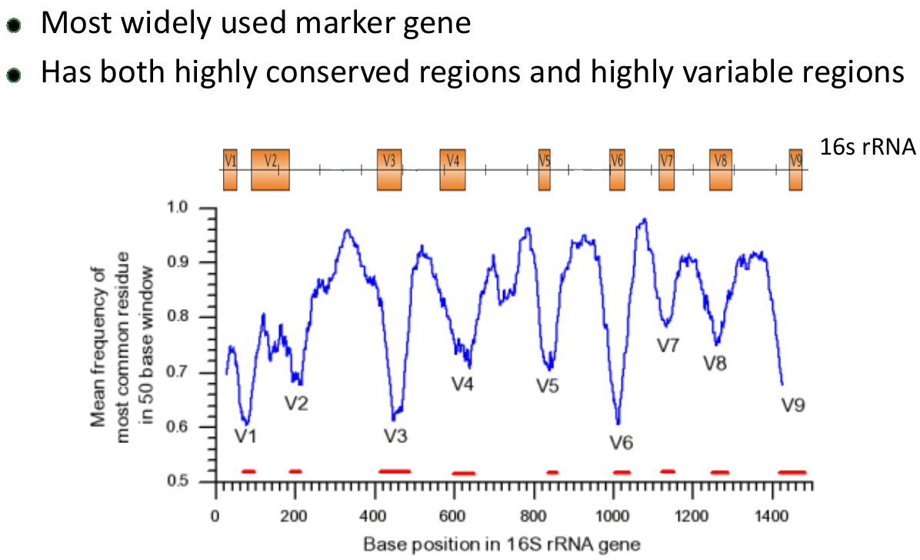
16s rRNA gene as a proxy for taxonomic assignment
10.1111/omi.12434

Slide 17
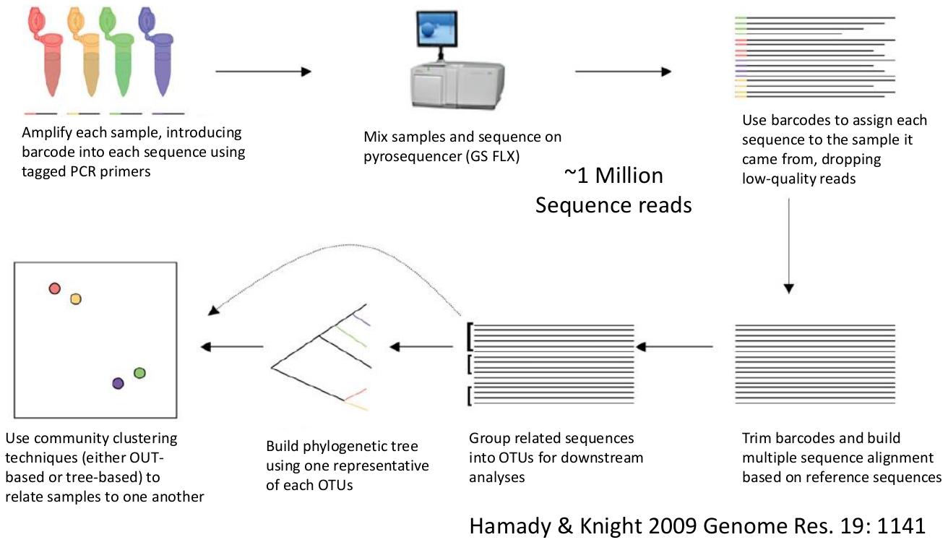
Overview of workflow with amplicon 16S metagenomics

Slide 18
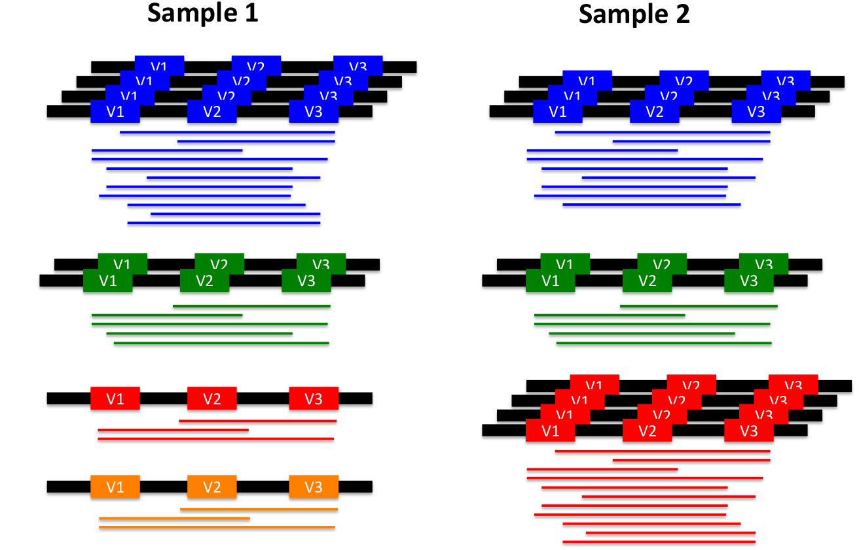
Metagenomic Sequencing: targeted 16S

Slide 19
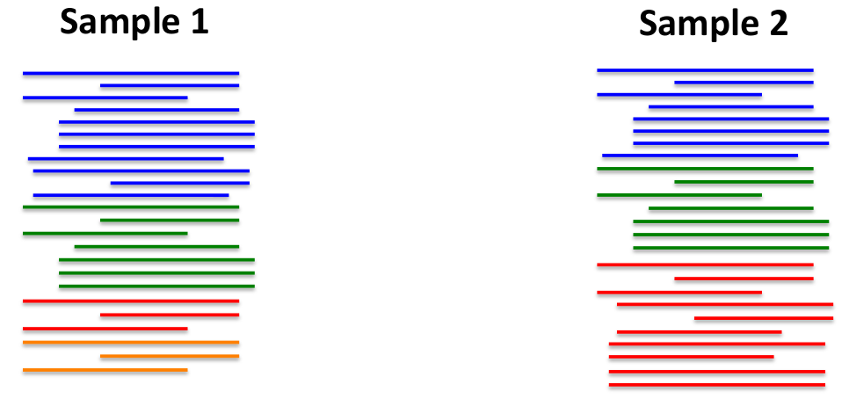
Metagenomic Sequencing: targeted 16S

Slide 20
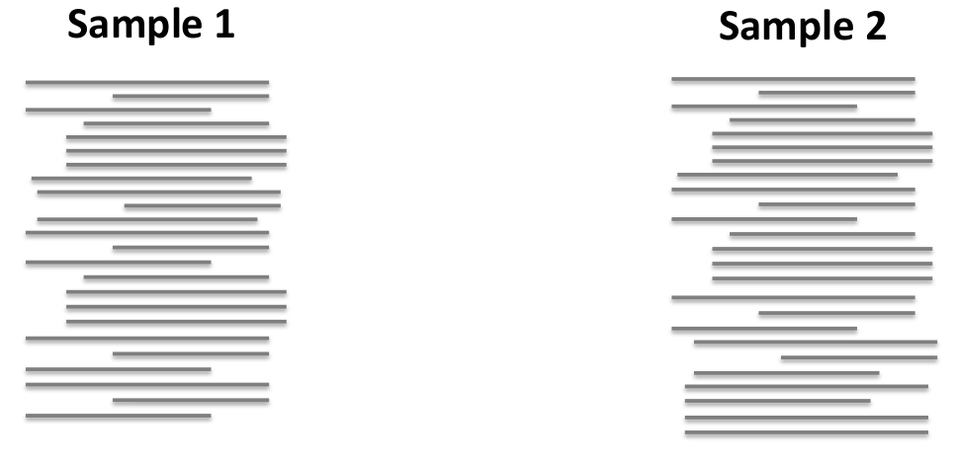
Metagenomic Sequencing: targeted 16S

Slide 21
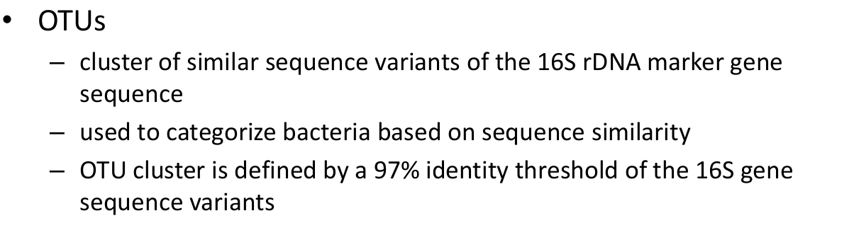
Operational Taxonomic Unit (OTU)

Slide 22
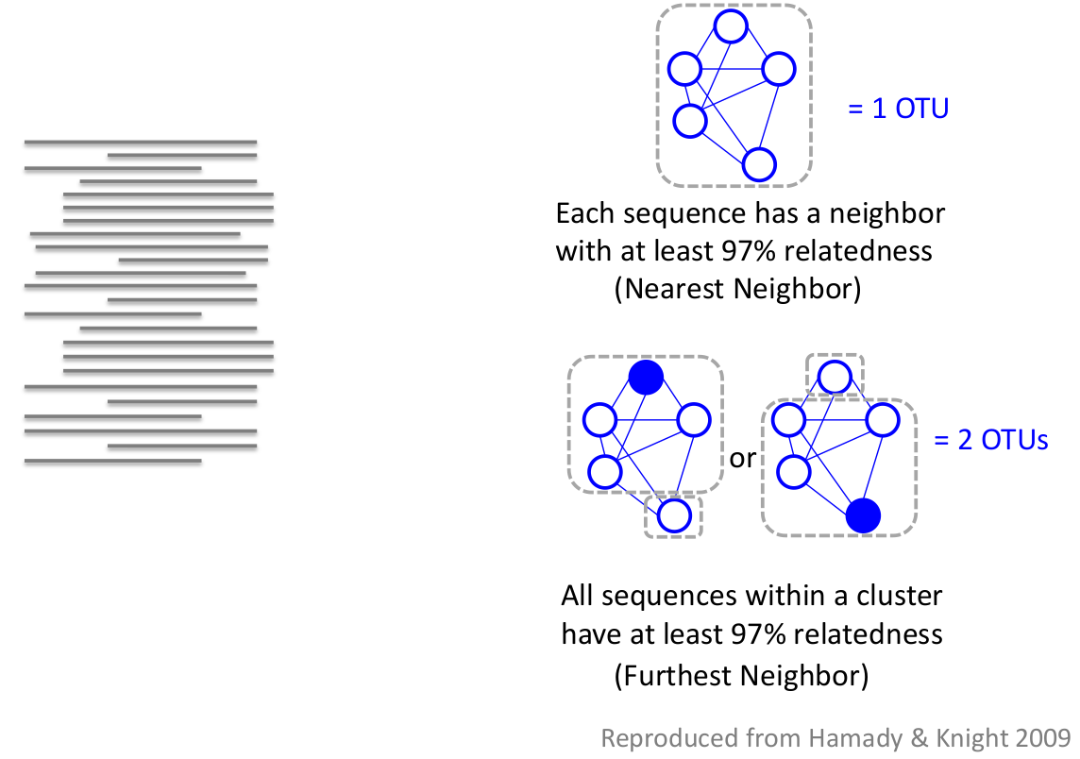
Clustering of OTUs

Slide 23
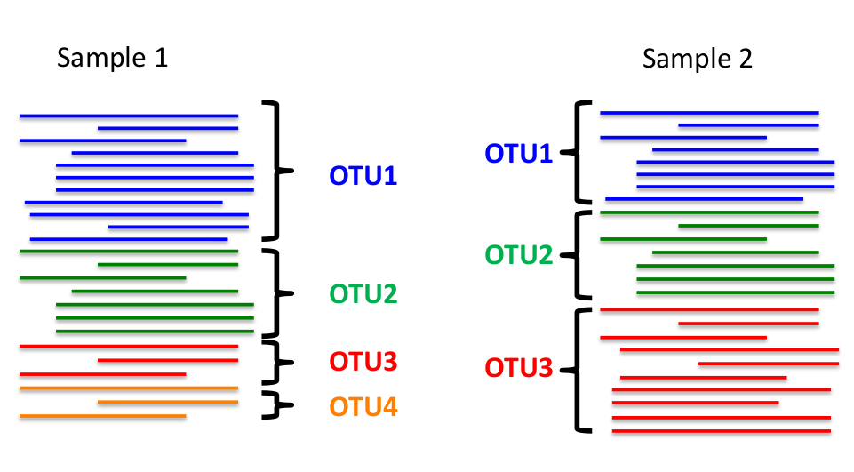
Clustering of OTUs

Slide 24
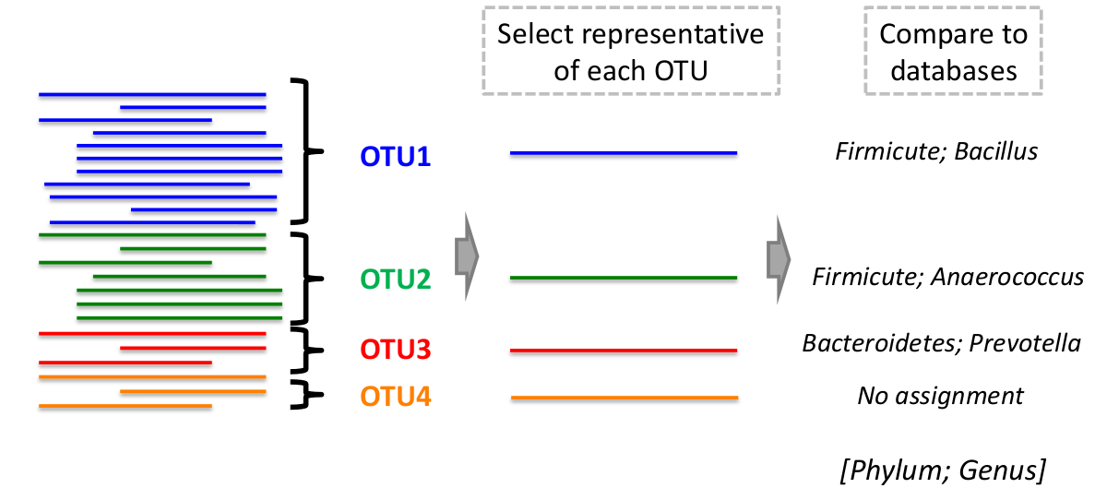
Taxonomic assignments of OTUs

Slide 25
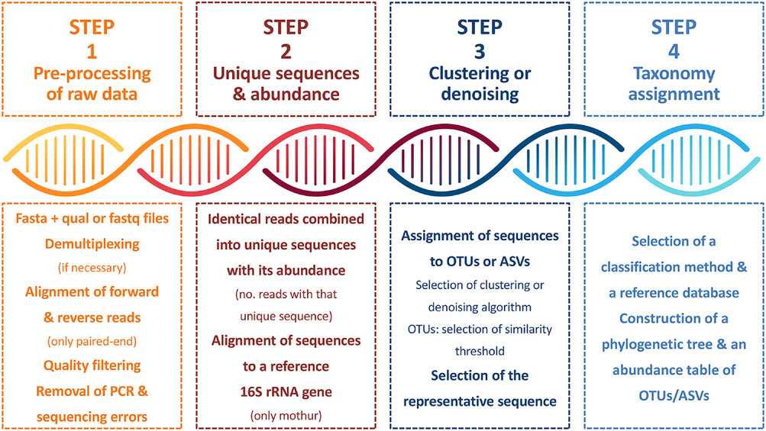
Workflow followed by the bioinformatics pipelines for processing 16S ribosomal ribonucleic acid (rRNA) gene amplicon data
ASVs, amplicon sequence variants; no., number; OTUs, operational taxonomic units; PCR, polymerase chain reaction.
10.1111/omi.12434

Slide 26
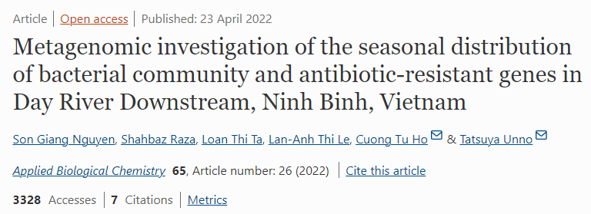
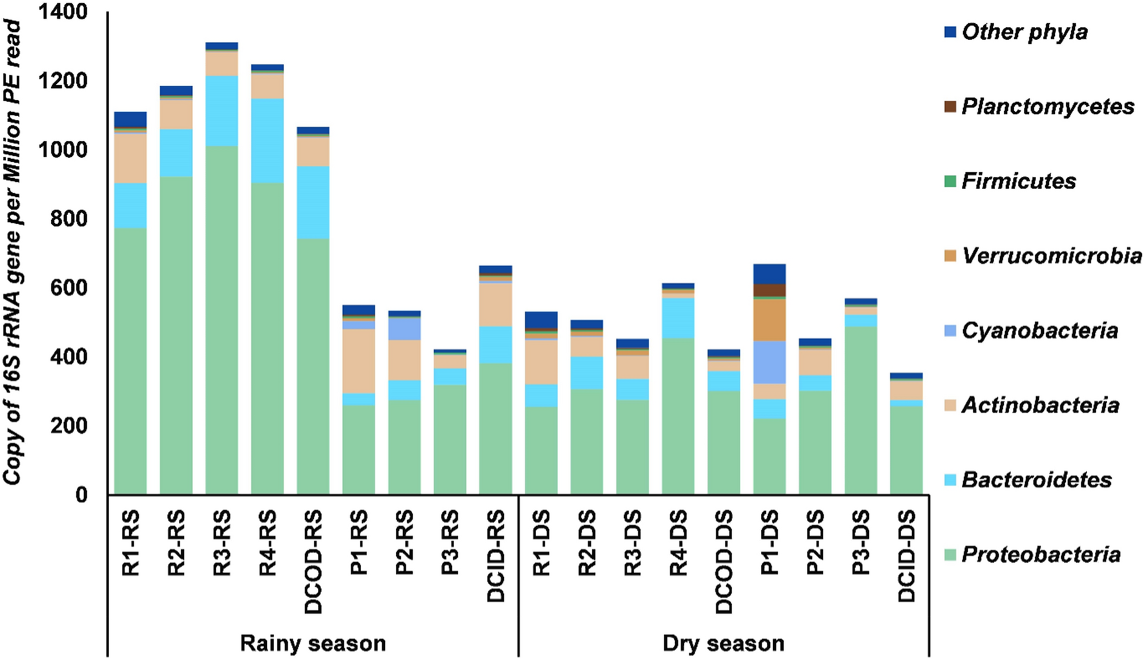
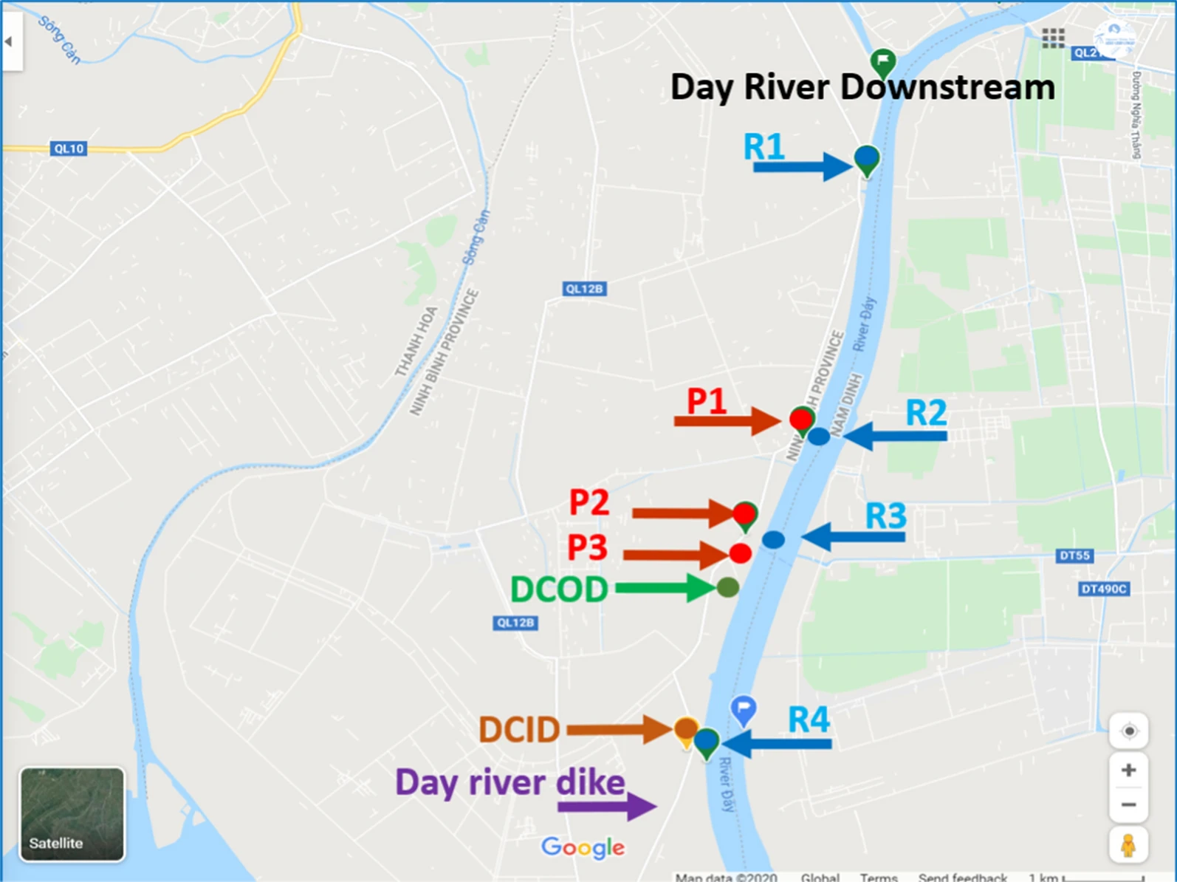
Seasonal Distribution of microbial communities of river and shrimp pond water samples at the phylum level. “Other classified phyla” indicates the sum of the abundance of phyla with their maximum relative abundance percentages lower than 1% in any sample. P1, P2, P3: three different shrimp pond sites; R1, R2, R3, R4: four different river sites. DCOD, DCID: discharged canals. P1, P2, P3, R1, R2, R3, R4 and DCOD located outside the Day River dike. DCID located inside the Day River dike. RS: rainy season; DS: dry season
10.1186/s13765-022-00687-w

Slide 27
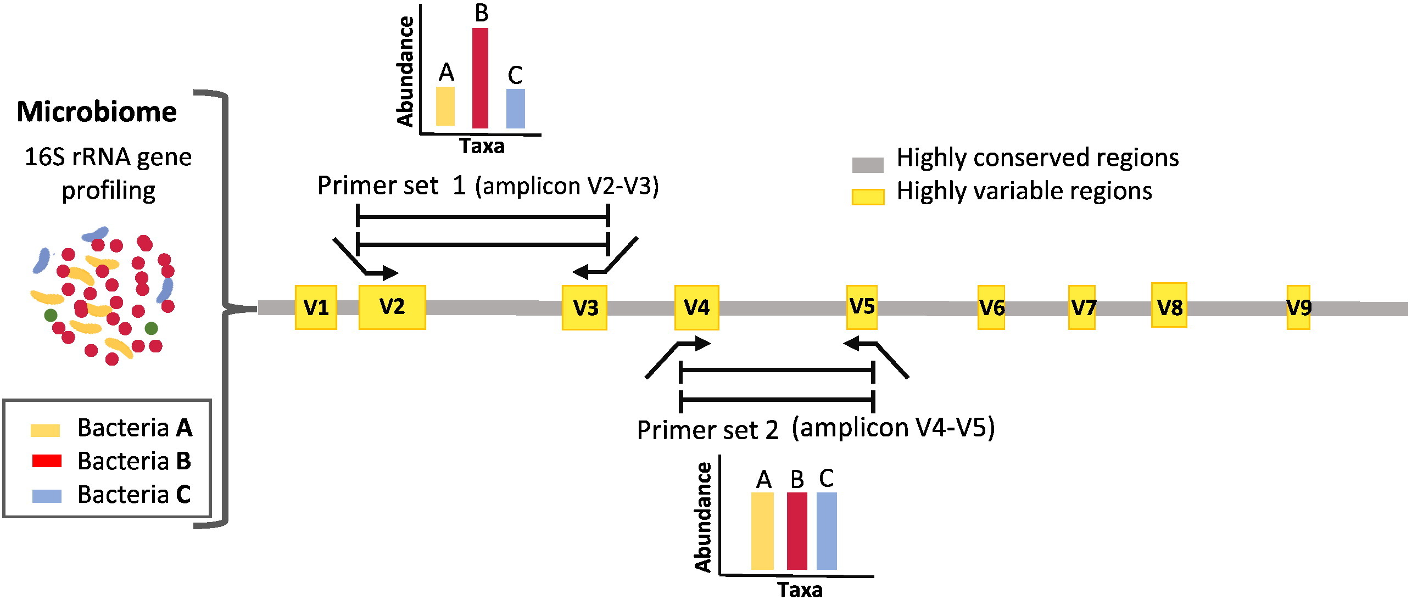
Microbiome profiling with 16S metagenomics
10.1016/j.csbj.2015.06.001

Slide 28
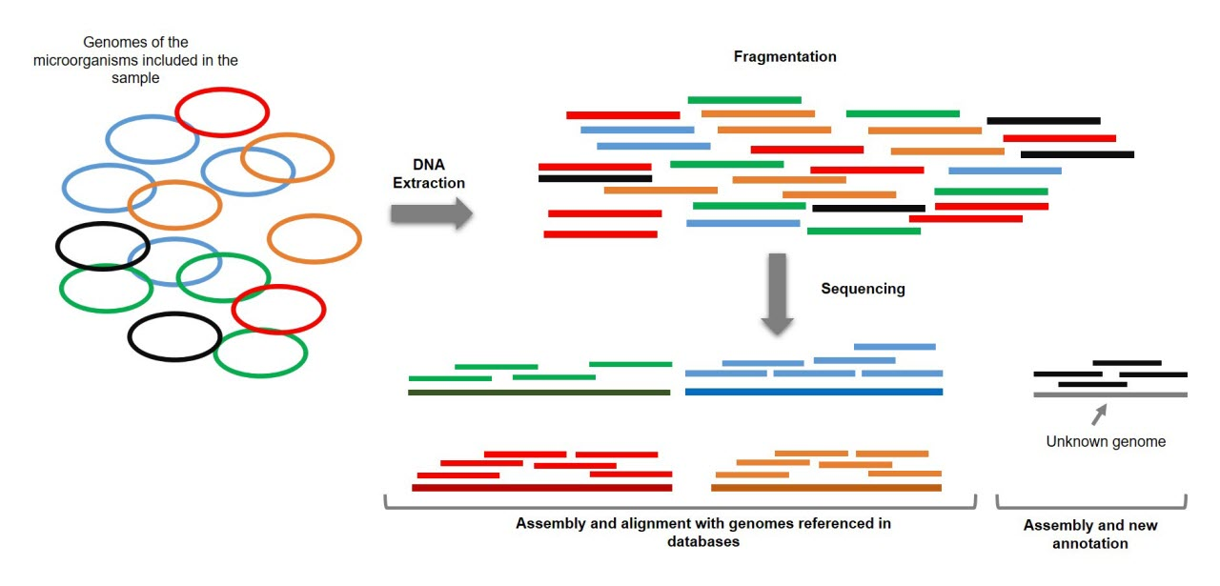
Shotgun Sequencing

Slide 29
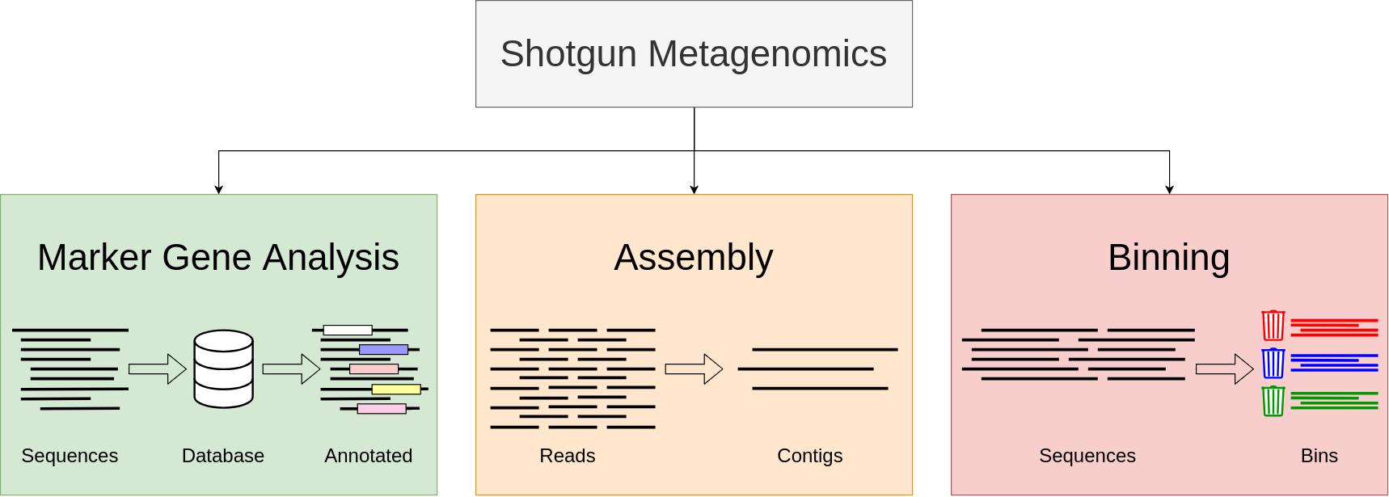
Shotgun Sequencing

Slide 30
Shotgun Sequencing
Denovo assembly: assembling reads into contigs without reference genomes
– a substantial fraction of the metagenome (~33%) is not well represented by reference genomes
Assembling reads from non-homogeneous sample with multiple species
Assigning unassembled sequences generated by shotgun high-throughput sequencing to the known gene sequences.
– the assessment of interactions that occur
within the microbiome
between a microbiome and its host

Slide 31
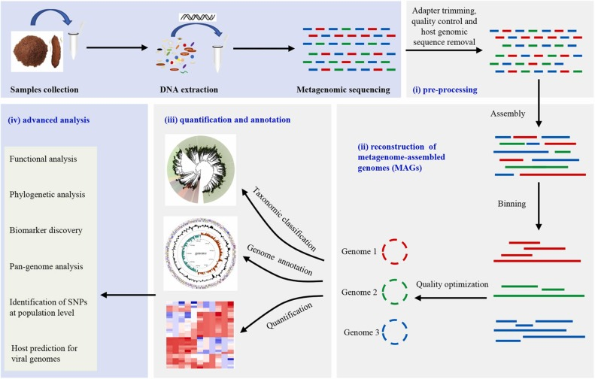
Shotgun Sequencing Analysis
10.1016/j.micres.2022.127023

Slide 32
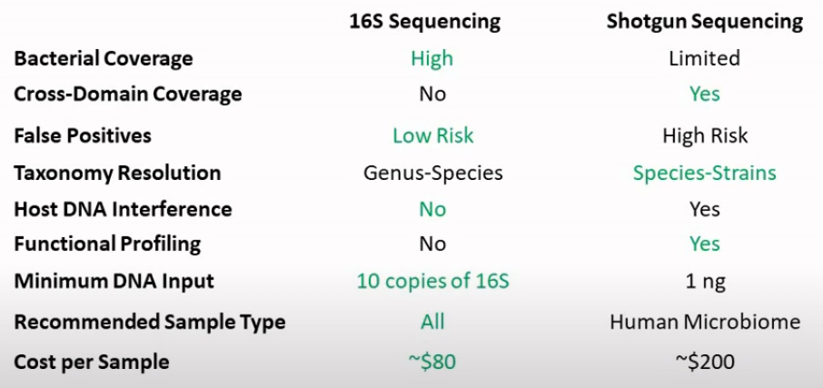
Amplicon 16S vs Shotgun Sequencing
30

Slide 33
Cross-Domain Coverage
16S limited to bacteria and Archaea
Shotgun is able to identify species from all 3 taxonomic domains (Archaea, the Bacteria, and the Eukarya), including virus

Slide 34
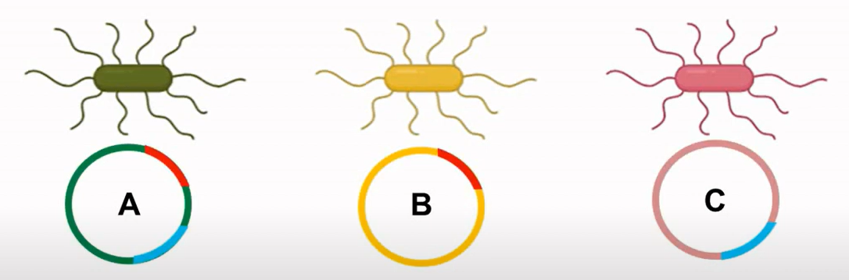
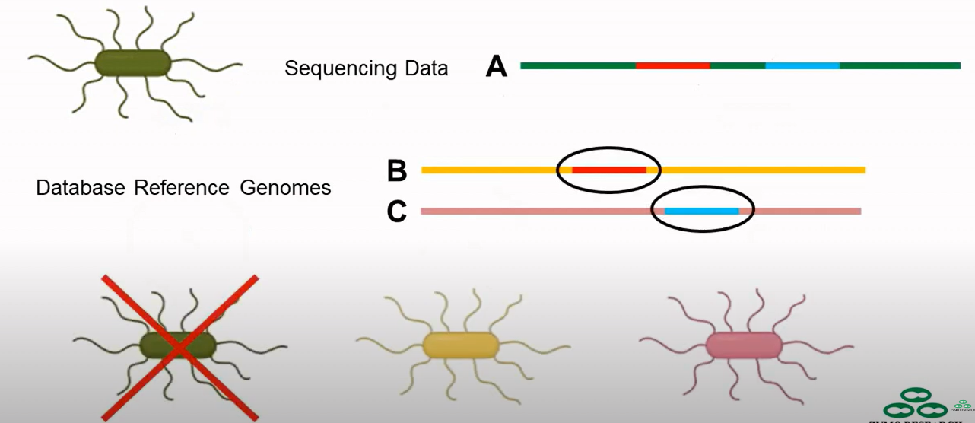
Shotgun Sequencing: False Positives

Slide 35
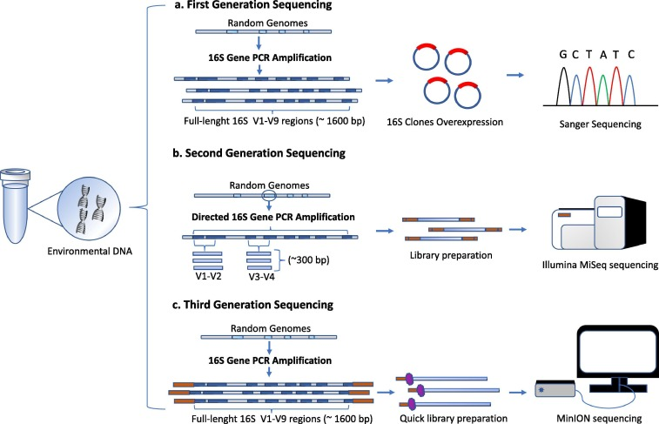
16S Metagenomics with long read ONT
10.1016/j.csbj.2020.01.005

Slide 36
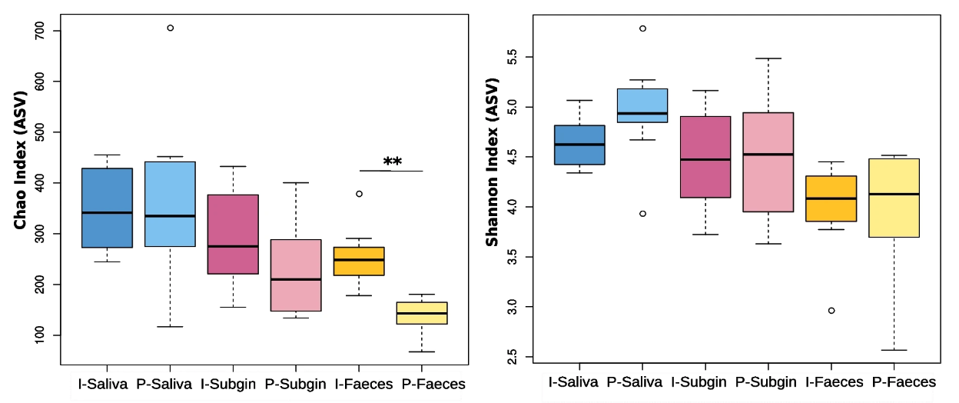
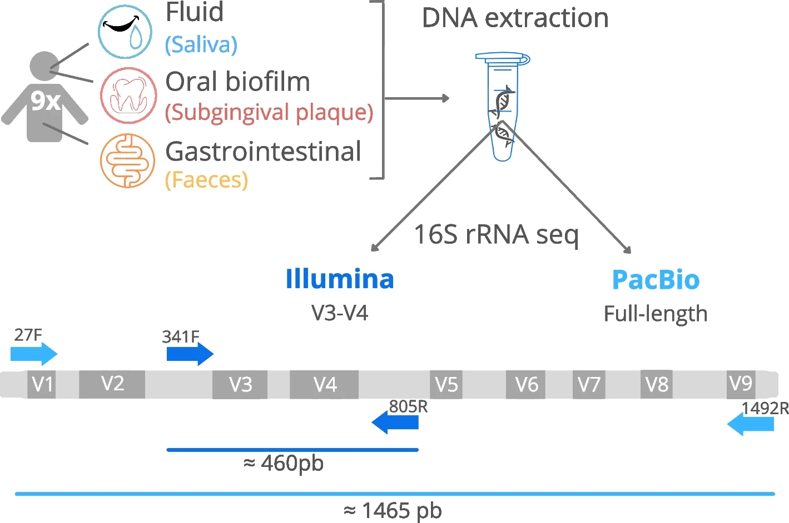
16S Metagenomics with long read Pacbio
10.1186/s12864-024-10213-5

Slide 37
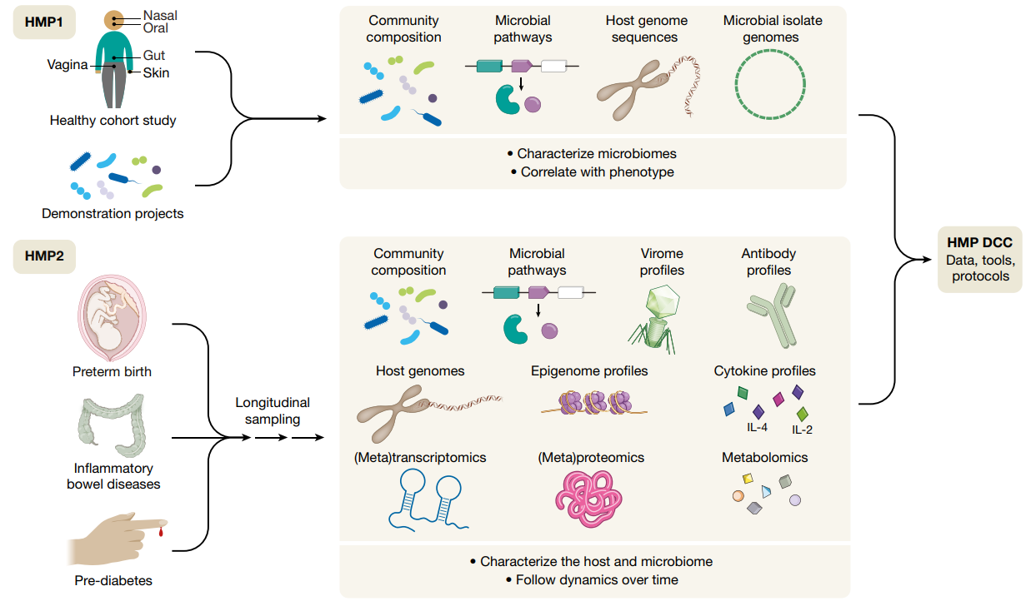
The first and second phases of the NIH Human Microbiome Project
https://www.nature.com/articles/s41586-019-1238-8

Slide 38
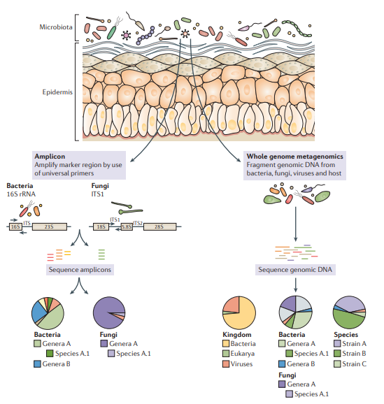
Human Skin Microbiome Project

Slide 39
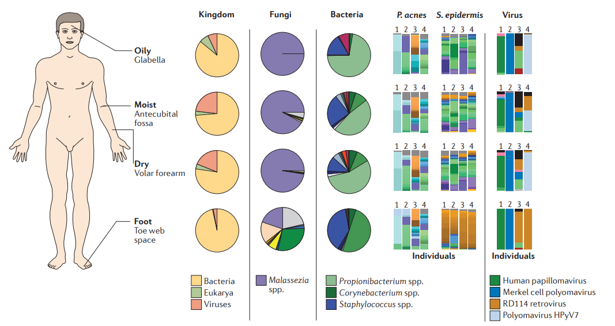
Human Skin Microbiome Project

Slide 40
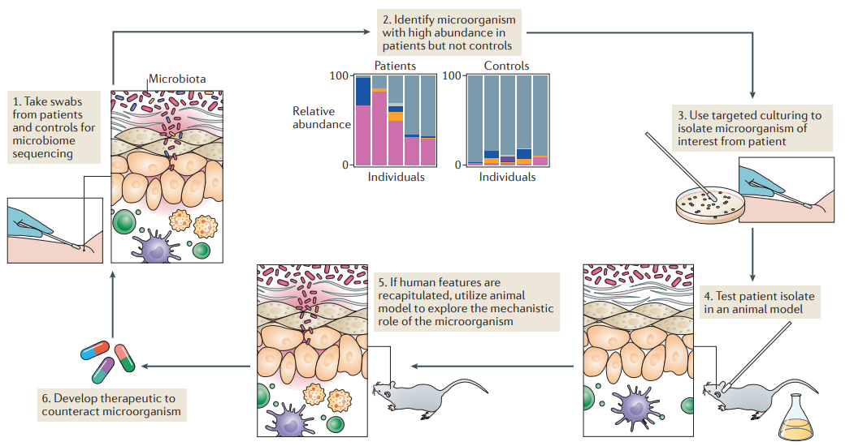
Human Skin Microbiome Project
Formulating testable hypotheses from sequencing data to generate novel therapeutics

Slide 41
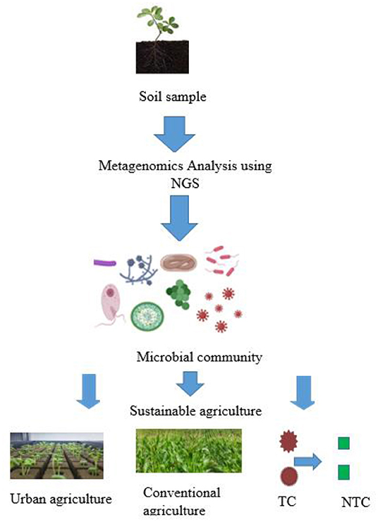
Soil microbial genetic diversity and their applications in sustainable agriculture
Microbes obtained and identified from rhizosphere soil can be harnessed to enhance plant growth and productivity in both urban and conventional agriculture.
Some of such microbes may also play a role in converting toxic contaminants to their respective non-toxic forms.
NGS, next generation sequencing
TC, toxic contaminants
NTC, non-toxic contaminants
https://www.frontiersin.org/articles/10.3389/fsufs.2022.886987

Slide 42
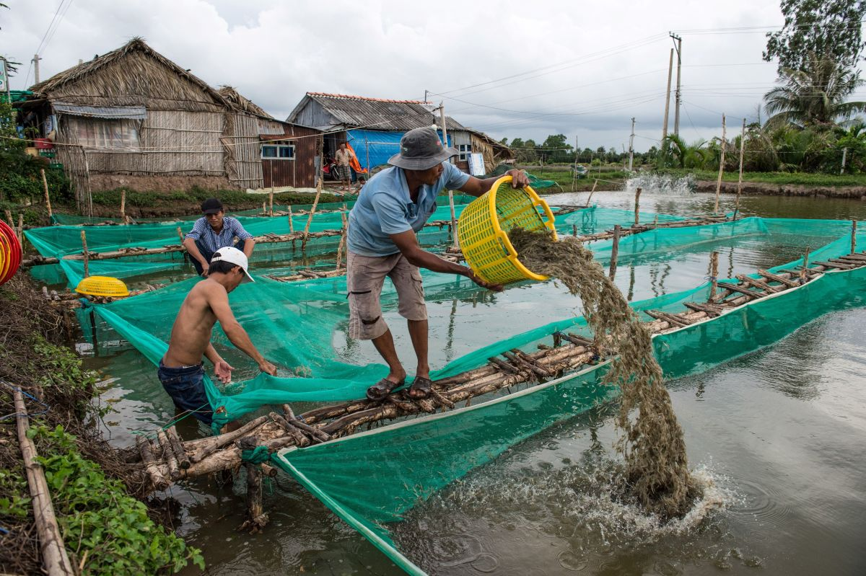
Discussion: Shrimp farming
Trial with Probiotics A in shrimp square
A + Nitrate/Nitric -> N2
How to check the alteration of shrimp gut microbiota?
How to check the alteration of shrimp square microbiota?

